Slide 1
GCSE Physics in a nutshell
Space Physics

Slide 2
GCSE Physics
Physics
1. Energy
2. Electricity
3. Particles
4. Atomic structure and radioactivity
5. Waves
6. Forces
7. Magnetism and electromagnetism
8. Space Physics
8.1. The universe and our solar system
8.1.1 What is the universe?
8.1.2 The solar system
8.1.3 Life cycle of a star
8.1.4 The expanding universe
8.1.5 The big bang theory

Slide 3
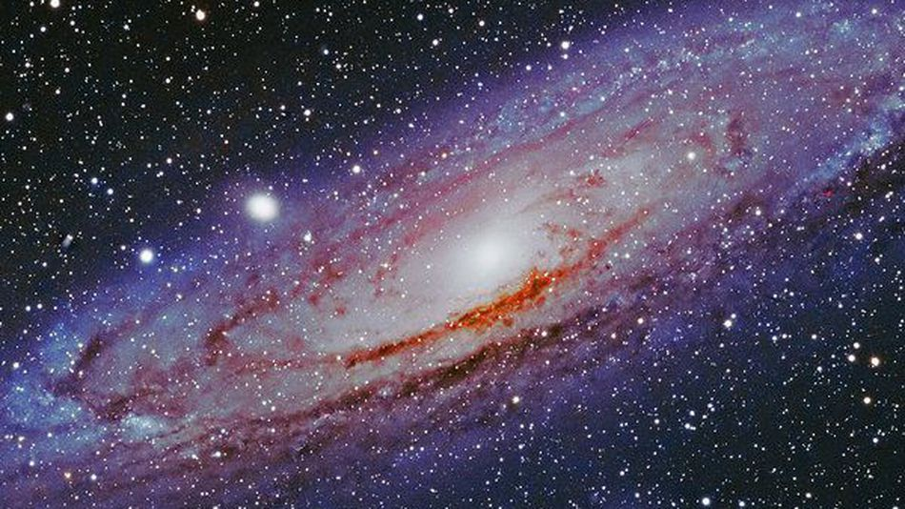
How would you define “the universe”? The universe is everything- all energy and all matter
Learning Outcome: Explain what is meant by the universe
Notes:
Buzzfeed
https://www.youtube.com/watch?v=1Eh5BpSnBBw
Morgan freeman
https://www.youtube.com/watch?v=qxXf7AJZ73A

Slide 4
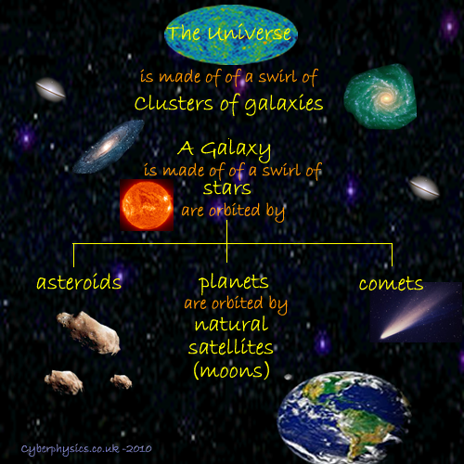
Learning Outcome: Explain what is meant by the universe
Notes:
Buzzfeed
https://www.youtube.com/watch?v=1Eh5BpSnBBw
Morgan freeman
https://www.youtube.com/watch?v=qxXf7AJZ73A

Slide 5
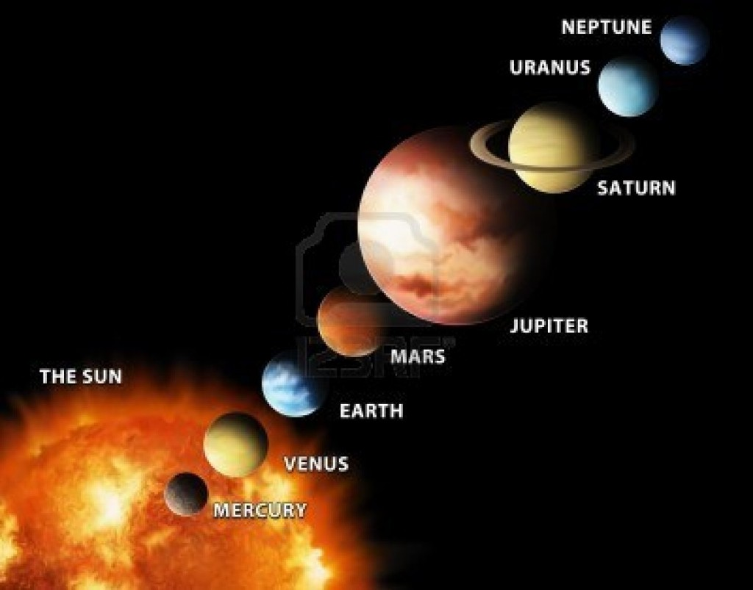
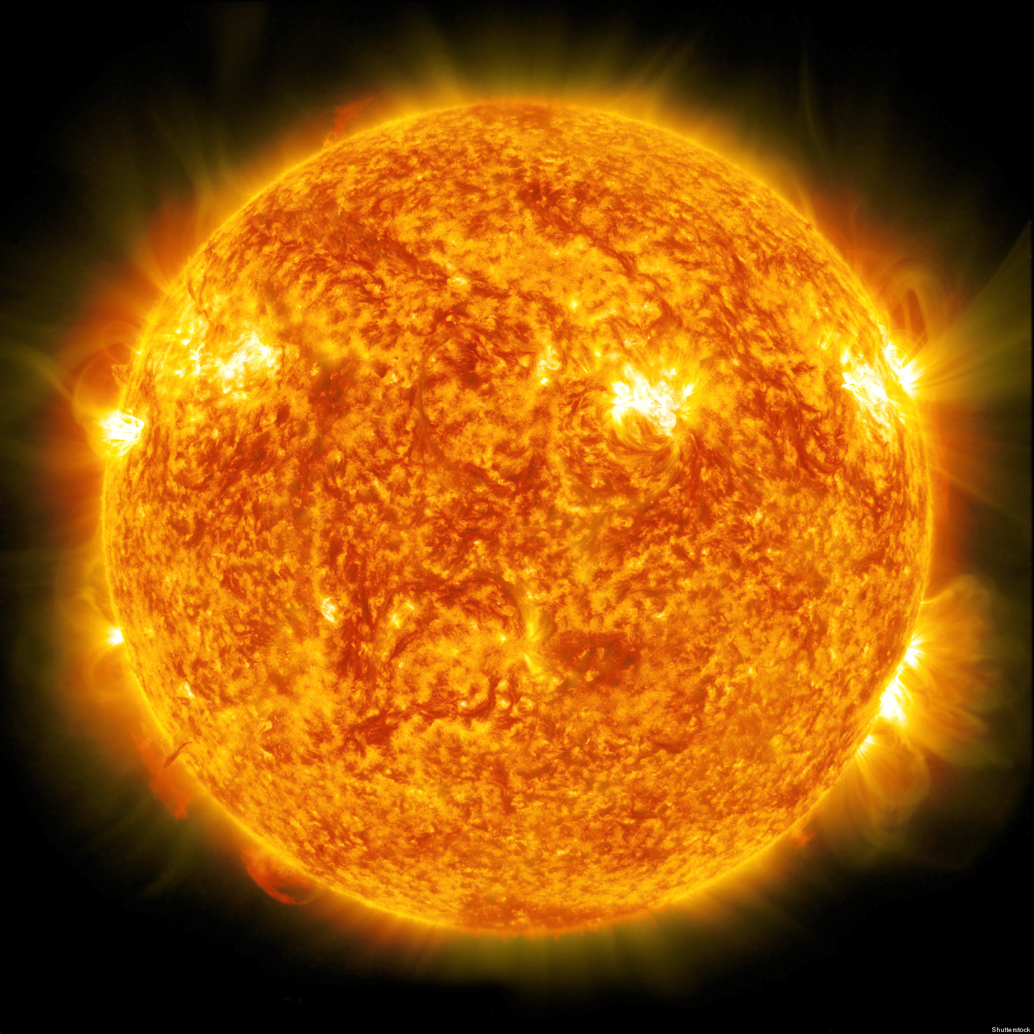
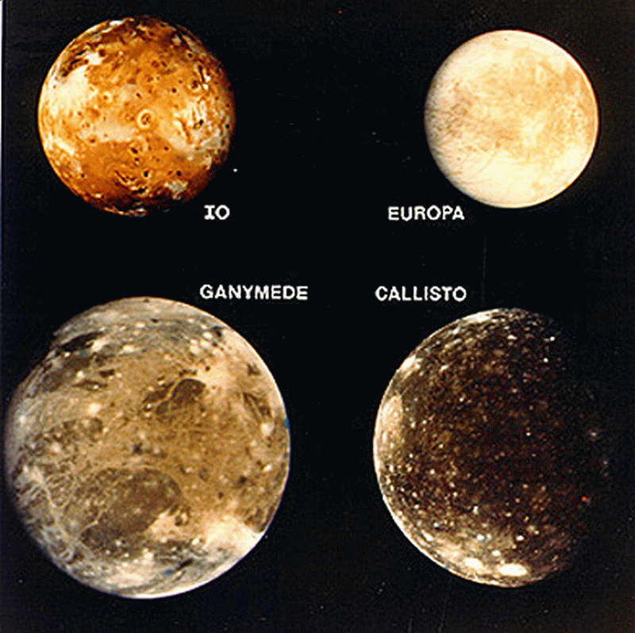
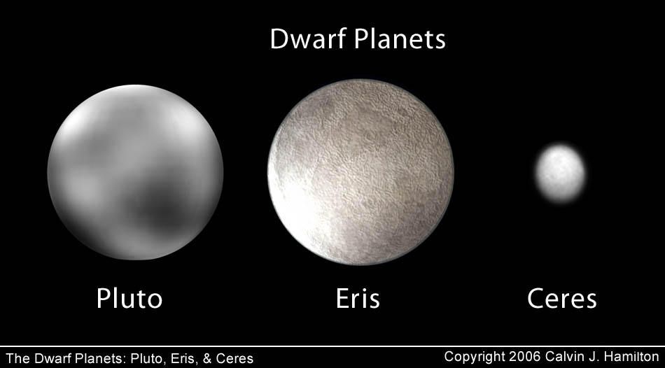
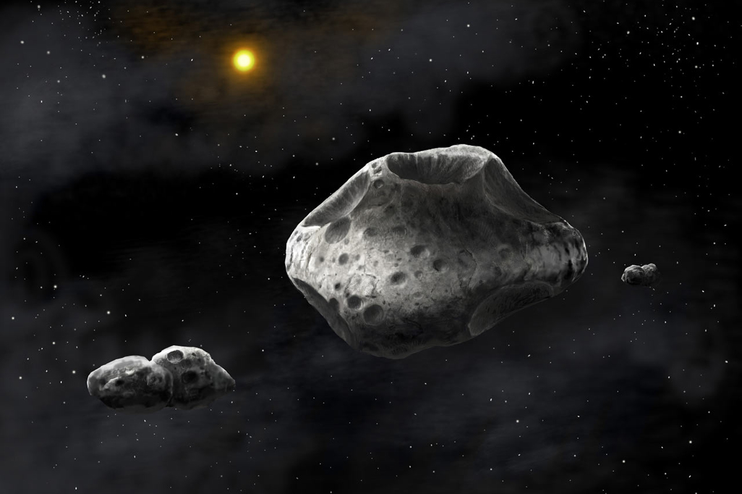
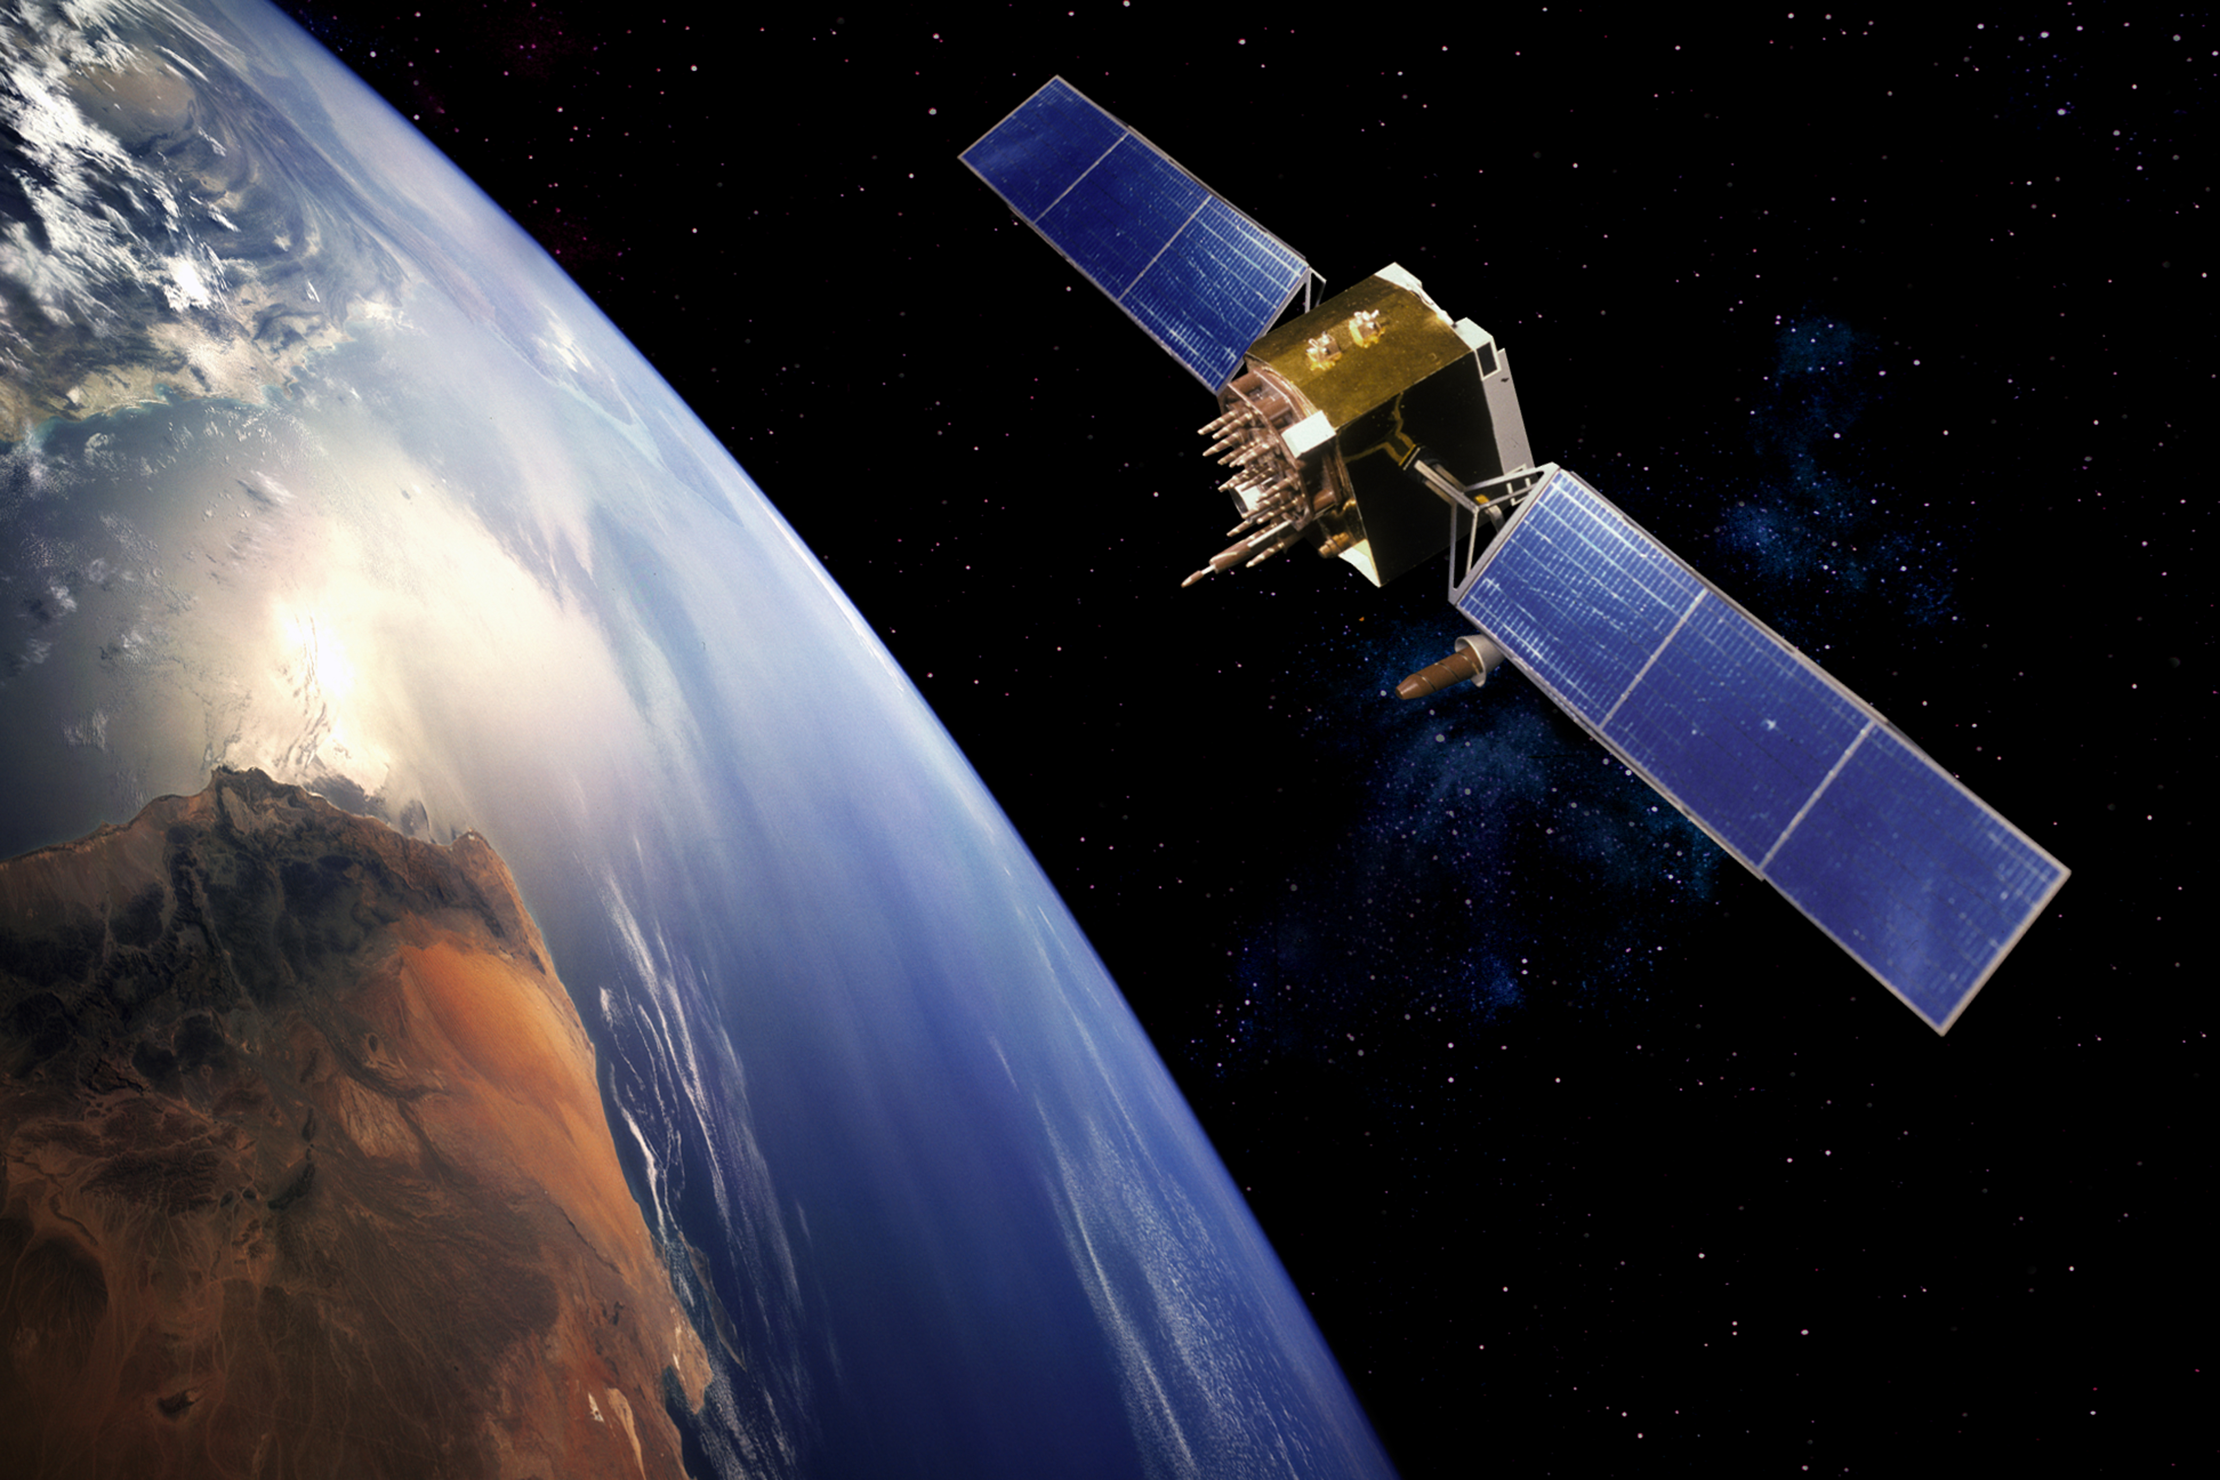
Learning Outcome: Describe features of our solar system
The sun
Natural satellites
The 8 planets
Our solar system
Artificial satellites
Dwarf planets
Asteroids

Slide 6
Learning Outcome: Describe features of our solar system

Slide 7
Learning Outcome: Describe features of our solar system
Notes:
Buzzfeed
https://www.youtube.com/watch?v=1Eh5BpSnBBw

Slide 8
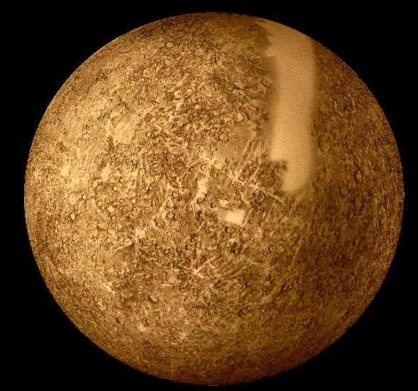
MERCURY Inner rocky planet
Mass Compared to the Earth: 5%
Diameter (km): 4880
Distance from the Sun (million km): 58
Orbital Time: 88 Days
Rotational Time: 59 hours
Average Surface Temperature (°C): 350
Mercury is the 2nd Hottest planet in the solar system. Despite being closer to the sun than Venus it is too small and therefore has insufficient gravitational attraction to maintain its own atmosphere. Any thin atmosphere it would have is pulled away by the Sun’s massive gravitational field.

Slide 9
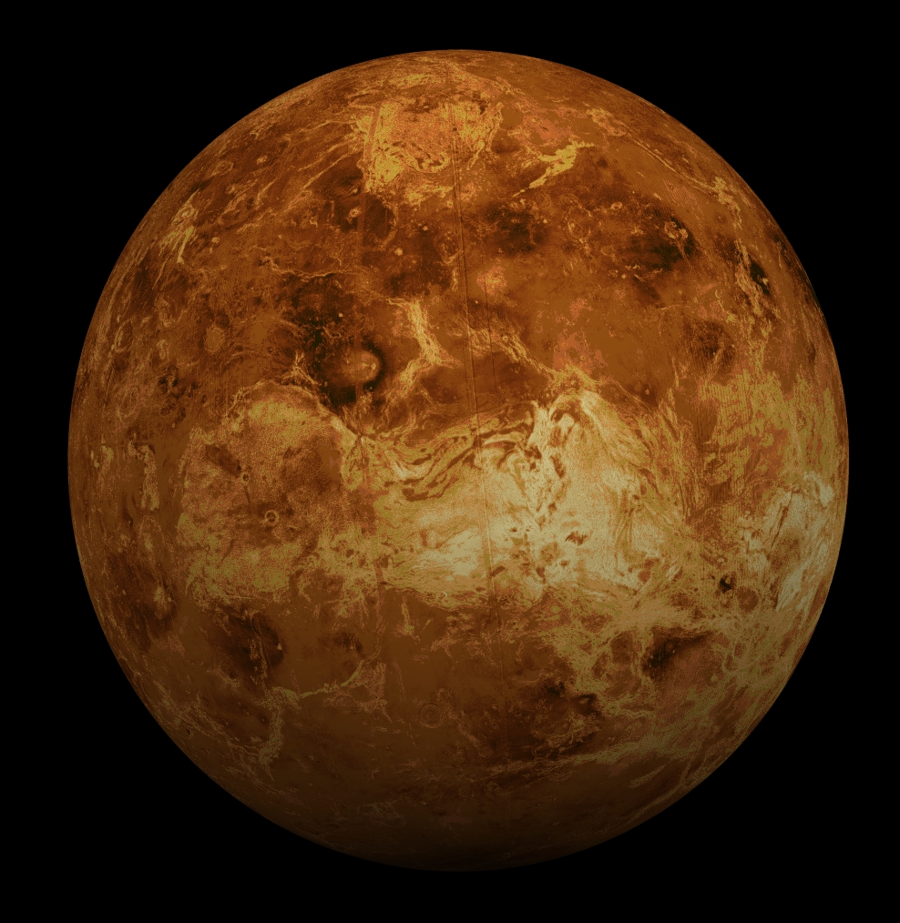
Mass Compared to the Earth: 81%
Diameter (km): 12112
Distance from the Sun (million km): 107.5
Orbital Time: 224 Days
Rotational Time: 243 hours
Average Surface Temperature (°C): 460
VENUS
Inner rocky planet
Venus is the hottest planet in the solar system. Despite being further away from the sun than Mercury it is nearly the same size as Earth so therefore has sufficient gravitational attraction to maintain its own atmosphere. This thick, dense atmosphere acts a trap for the Sun’s heat due to the greenhouse effect.

Slide 10
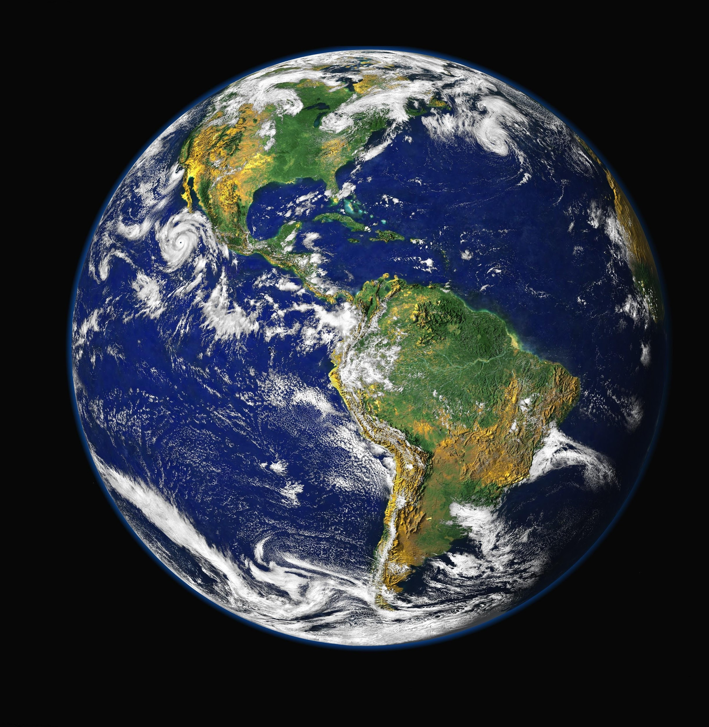
Mass Compared to the Earth: 100%
Diameter (km): 12742
Distance from the Sun (million km): 149.6
Orbital Time: 365.25 Days
Rotational Time: 24 hours
Average Surface Temperature (°C): 20
EARTH
Inner rocky planet
Earth is the largest rocky planet in the solar system. It is our home and is the only planet which we currently are aware of which can sustain life.
It exists in the “Goldilocks Region” of space where it is not too hot or too cold for life to exist.
It is the optimum temperature for water to exist as a liquid, which is key ingredient for life.

Slide 11
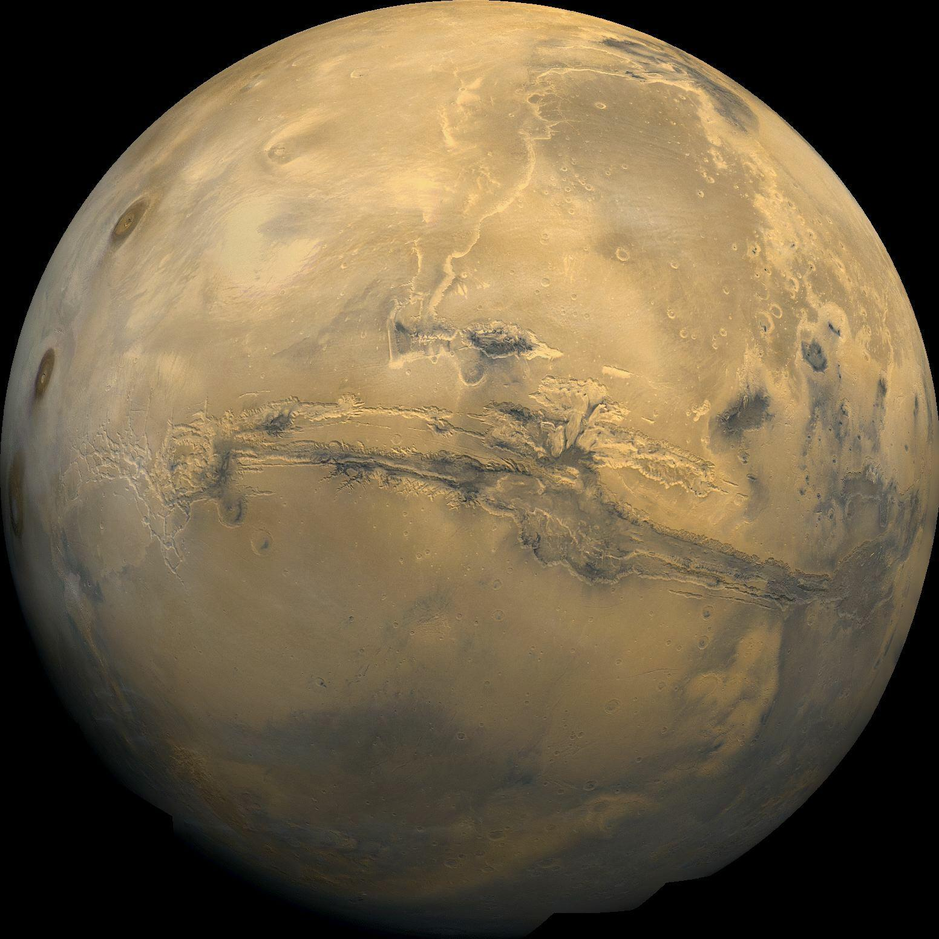
Mass Compared to the Earth: 11%
Diameter (km): 6790
Distance from the Sun (million km): 228
Orbital Time: 687 Days
Rotational Time: 24 hours and 37 mins
Average Surface Temperature (°C): -23
MARS
Inner rocky planet
Mars is known as the red planet. This is because on the surface the rock is rich in iron which gives it a characteristic red colour.
Mars is covered in evidence of erosion and weathering similar to an environment covered in water.
We have landed rovers on Mars and proven there is trace amounts of water on the Martian surface.

Slide 12
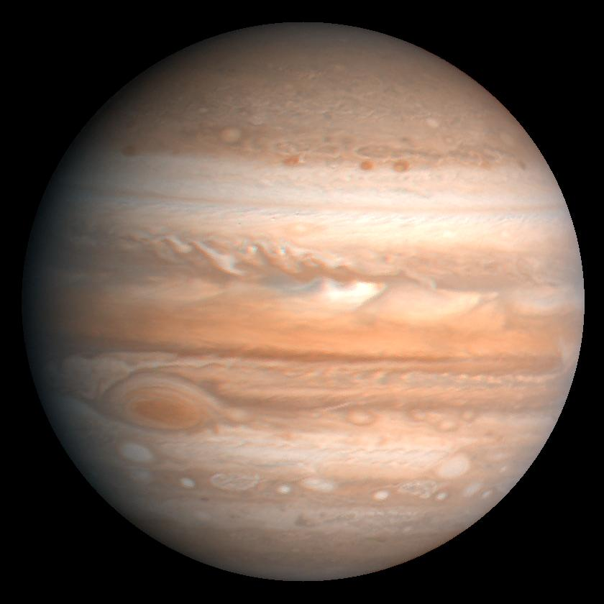
JUPITER Outer gas planet
Mass Compared to the Earth: 3180%
Diameter (km): 142600
Distance from the Sun (million km): 778
Orbital Time: 11.9 Years
Rotational Time: 9 hours and 50 mins
Average Surface Temperature (°C): -120
Jupiter is the largest planet in our solar system and is the first gas planet. It is large enough to fit every other planet inside and still have room to spare.
It is also home to the largest storm in the solar system; the infamous “Great Red Spot”, so large it could fit Earth and Mars inside.
Jupiter also has at least 67 moons.
Great Red Spot

Slide 13
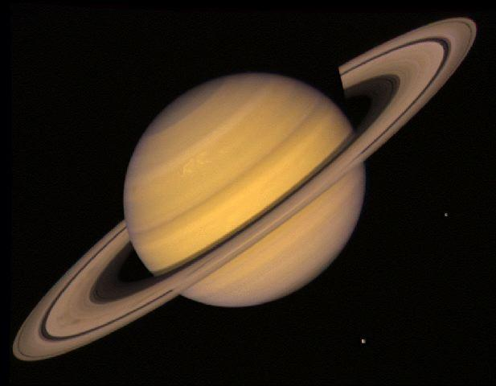
Mass Compared to the Earth: 950%
Diameter (km): 120200
Distance from the Sun (million km): 1427
Orbital Time: 29.5 Years
Rotational Time: 10 hours and 14 mins
Average Surface Temperature (°C): -180
SATURN
Outer gas planet
Saturn is the 2nd largest planet of our solar system with at least 46 moons, including the largest moon of our solar system, Titan.
Saturn is also famous for its unique ring system, the largest in our solar system, made of ice and dust. The ring system is heavily influenced by Saturn’s many moons.

Slide 14
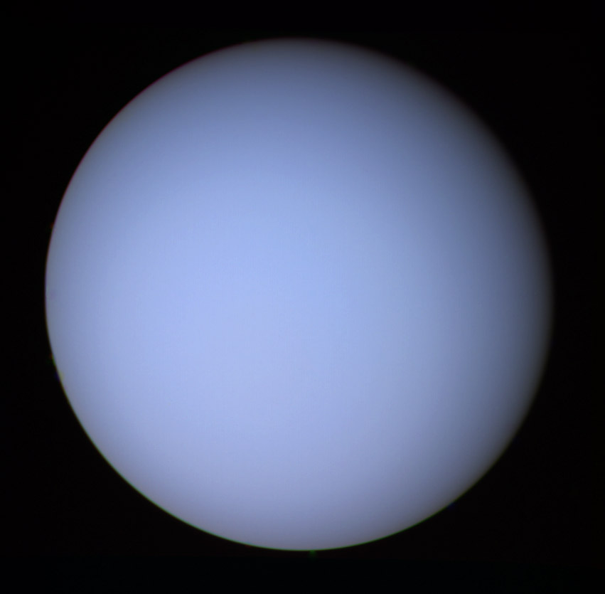
Mass Compared to the Earth: 14.5%
Diameter (km): 49000
Distance from the Sun (million km): 2870
Orbital Time: 84 Years
Rotational Time: 10 hours and 49 mins
Average Surface Temperature (°C): -210
URANUS
Outer gas planet
Uranus is the 7th planet from the sun in our solar system. Uranus like Saturn has rings, however they are much smaller in comparison.
Uranus' blue colour is the result of absorption of red light by methane in the upper atmosphere.

Slide 15
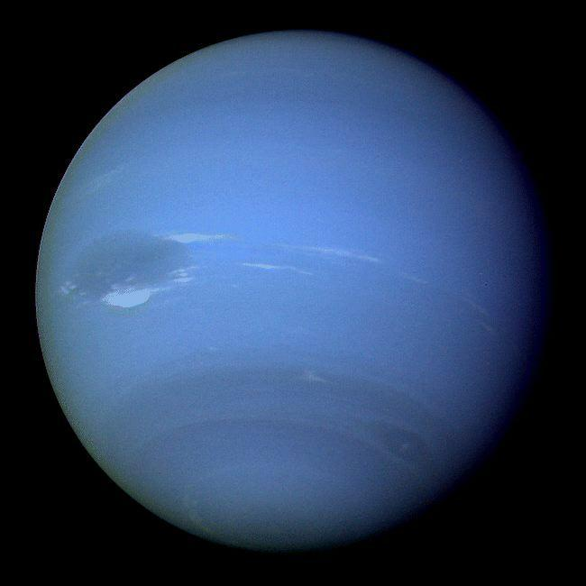
Mass Compared to the Earth: 17.5%
Diameter (km): 50000
Distance from the Sun (million km): 4497
Orbital Time: 165 Years
Rotational Time: 15 hours and 48 mins
Average Surface Temperature (°C): -220
NEPTUNE
Outer gas planet
Neptune is the 8th and final planet and has 13 moons.
Like the other gas planets Neptune has very rapid winds. Neptune has the fastest winds in the solar system of speeds up to 2000 km/hour!

Slide 16
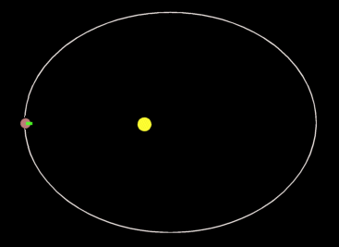
Learning Outcome: Describe how and why objects orbit other objects
Gravitational force pulls orbiting body constantly inwards
Speed is constant
But change in direction = change in velocity (vector)
Change in velocity = acceleration
Original direction of travel
New resultant direction of travel due to gravitational force

Slide 17
GCSE Physics
Physics
1. Energy
2. Electricity
3. Particles
4. Atomic structure and radioactivity
5. Waves
6. Forces
7. Magnetism and electromagnetism
8. Space Physics
8.1. The universe and our solar system
8.1.1 What is the universe
8.1.2 The solar system
8.1.3 Life cycle of a star
8.1.4 The expanding universe
8.1.5 The big bang theory

Slide 18
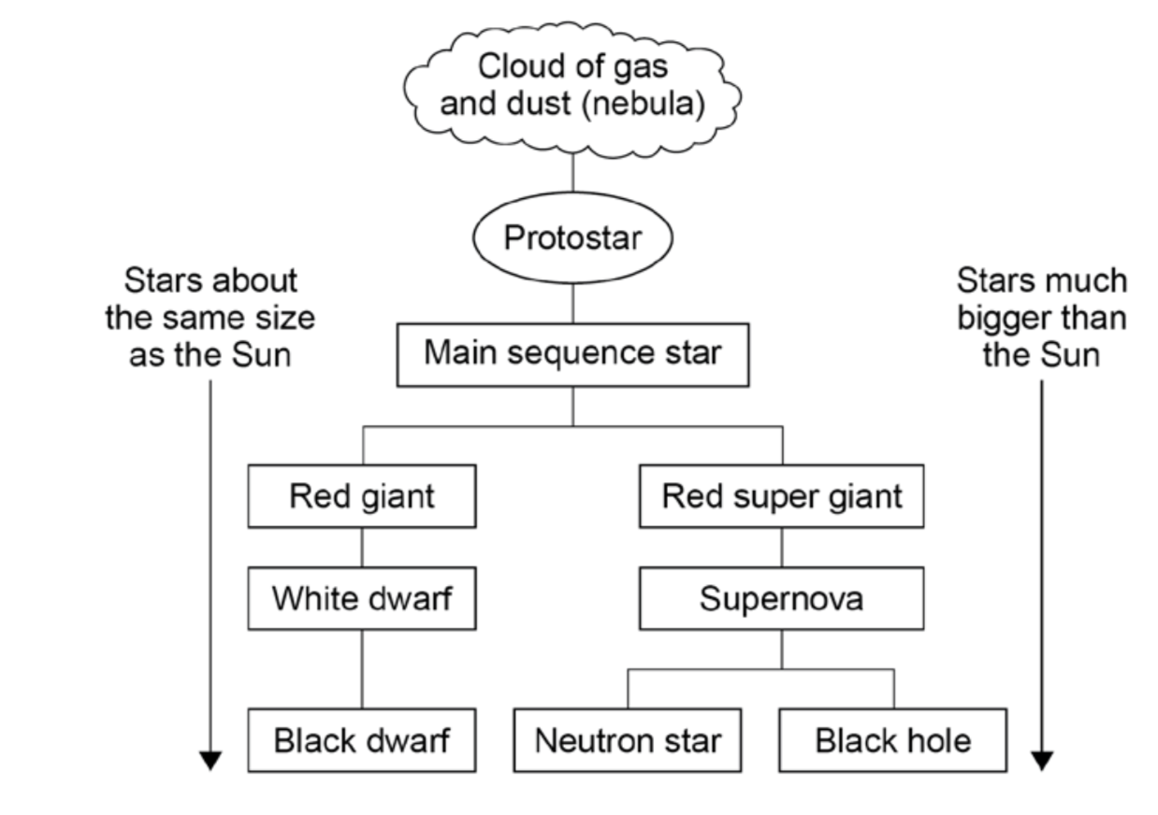

Slide 19
GCSE Physics
Physics
1. Energy
2. Electricity
3. Particles
4. Atomic structure and radioactivity
5. Waves
6. Forces
7. Magnetism and electromagnetism
8. Space Physics
8.1. The universe and our solar system
8.1.1 What is the universe
8.1.2 The solar system
8.1.3 Life cycle of a star
8.1.4 The expanding universe
8.1.5 The Big Bang theory

Slide 20
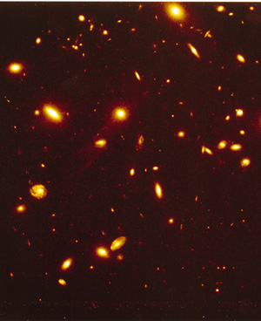
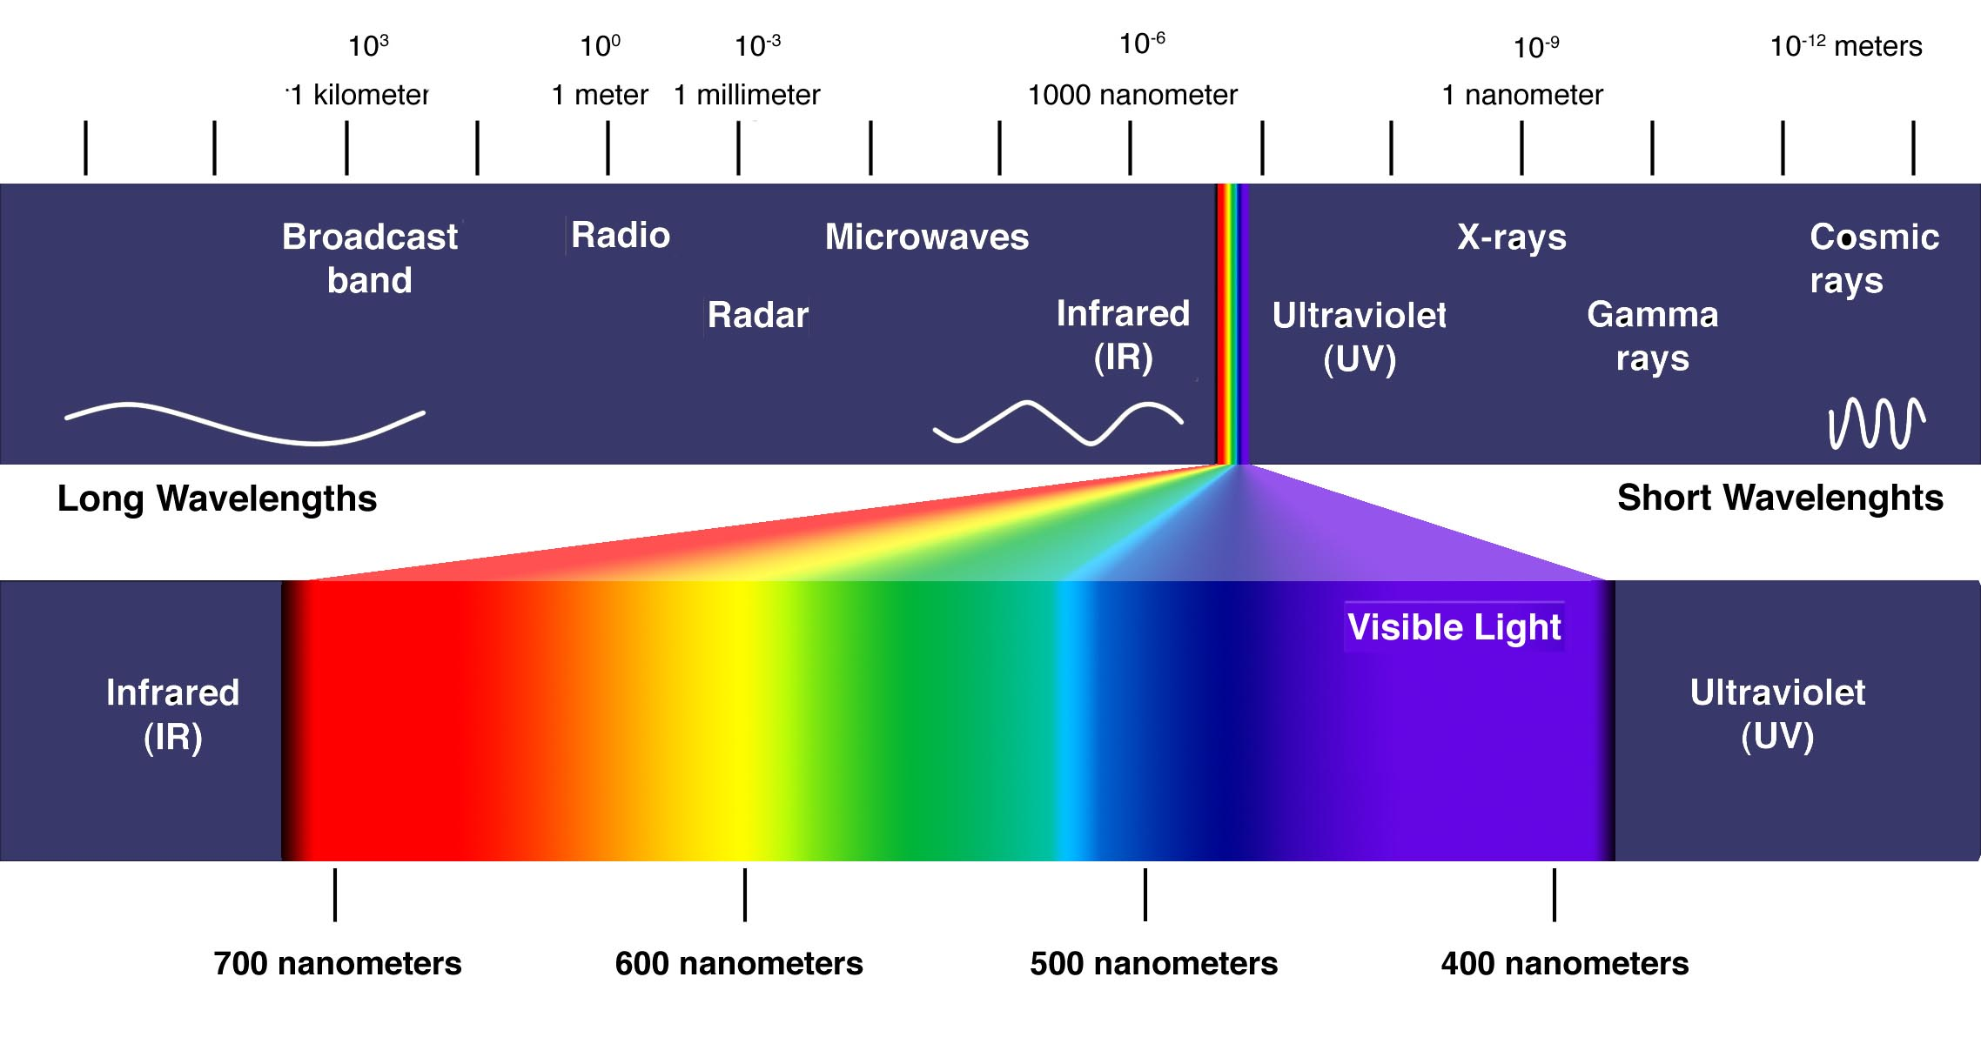
Doppler effect- apparent change in frequency and wavelength of any wave due to relative motion between wave source and observer Moving away = smaller frequency/elongated wavelength Moving towards = higher frequency/shortened wavelength Galaxies appear red shifted (small frequency/longer wavelength) suggesting that they are moving away from us
Learning Outcome: Link redshift of galaxies to the big bang theory

Slide 21
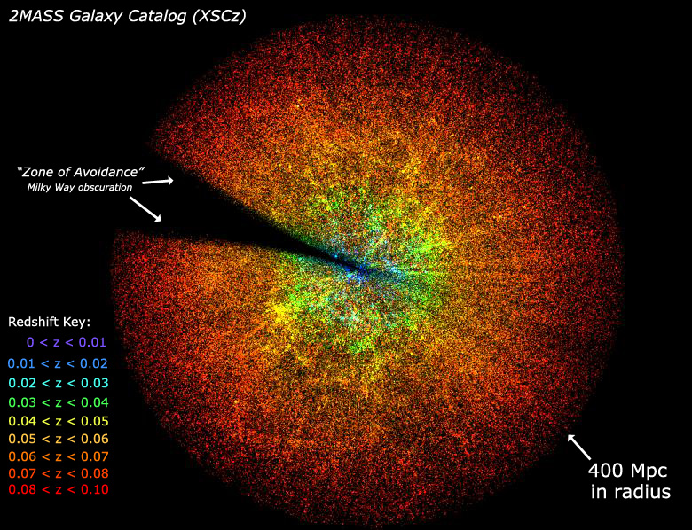
Hubble confirmed with measurements that galaxies further away from us are moving more quickly away from us (are more red shifted). This means the universe is expanding
Learning Outcome: Link redshift of galaxies to the big bang theory

Slide 22
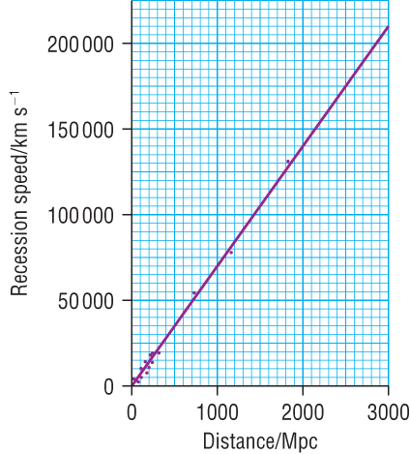
Hubble’s Law
Learning Outcome: Link redshift of galaxies to the big bang theory
The speed of the recession of a galaxy is directly proportional to its distance from the Earth.
The universe started from a very hot, very dense singularity which rapidly expanded and cooled. This is the big bang theory

Slide 23
Hubble’s Law doesn’t actually work… The expansion of the universe is actually accelerating
Learning Outcome: Examine our limited knowledge of the universe
Notes:
https://www.youtube.com/watch?v=tXkBfkeJJ5c

Slide 24
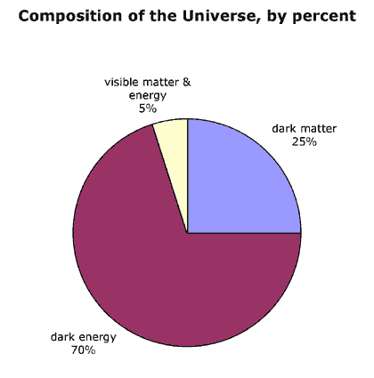
What’s the matter?
Learning Outcome: Examine our limited knowledge of the universe
In the 1990s it was observed that galaxies were accelerating away.
This means a repulsive force must be driving this acceleration.
Dark energy is the name given to the unknown material that has this repulsive property

